Slide 1
Advanced Example: Image De-Noising
Image de-noising is the process of removing image noise while at the same time trying to preserve details and structures.
We will use the Rudin- Osher- Fatemi de-noising model (ROF)

Slide 2
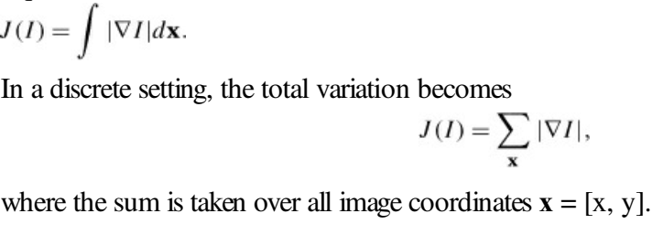
The total variation (TV) of a (gray scale) image I is defined as the sum of the gradient norm

Slide 3
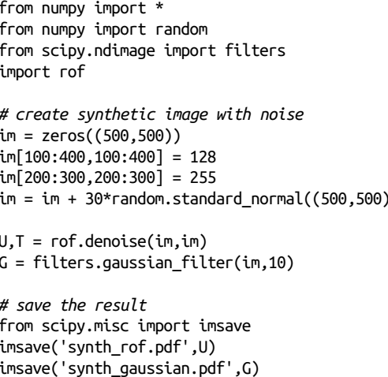
Example

Slide 4
Local Image Descriptors
Finding corresponding points and regions between images.
Two different types of local descriptors are introduced with methods for matching these between images.
1.Harris Corner Detector
2.SIFT—Scale-Invariant Feature Transform

Slide 5
1.Harris Corner Detector
The Harris corner detection algorithm is one of the simplest corner indicators available.
The general idea is to locate interest points where the surrounding neighborhood shows edges in more than one direction
These are called image corners.

Slide 6
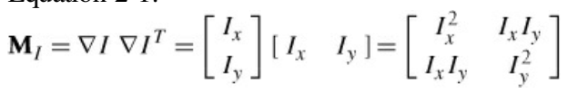
We define a matrix MI = MI(x),
on the points x in the image domain, as the positive semidefinite, symmetric matrix

Slide 7

Let W be a weight matrix (typically a Gaussian filter Gσ). The component-wise convolution
gives a local averaging of MI over the neighboring pixels.
The resulting matrix is sometimes called a Harris matrix. The width of W determines a region of interest around x

Slide 8
Depending on the values of ∇I in the region, there are three cases for the eigenvalues of the Harris matrix, :
1. If λ1 and λ2 are both large positive values, then there is a corner at x.
2. If λ1 is large and λ2 ≈ 0, then there is an edge and the averaging of MI over the region doesn’t change the eigenvalues that much
3. If λ1 ≈ λ2 ≈ 0, then there is nothing

Slide 9
SIFT—Scale-Invariant Feature Transform
One of the most successful local image descriptors in the last decade is the Scale Invariant Feature Transform (SIFT), introduced by David Lowe
SIFT includes both an interest point detector and a descriptor.
The descriptor is very robust and is largely the reason behind the success and popularity of SIFT.

Slide 10
SIFT interest point locations are found using difference-of-Gaussian functions
D(x, σ) = [Gkσ (x) – Gσ (x)] * I(x) = [Gkσ – Gσ] * I = Ikσ – Iσ
where Gσ is the Gaussian 2D kernel
Iσ the Gσ-blurred grayscale image
k a constant factor determining the separation in scale.
Interest points are the maxima and minima of D(x, σ) across both image location and scale

